Slide 1



MICROCONTROLLER BASED SYSTEM DESIGN
CSE 3215
Lecture 6

Slide 2
Status Register (SREG)
The flag register in the AVR is called the status register (SREG).
It is an 8 bit register.
The ALU supports arithmetic and logic operations between registers or between a constant and a register. Single register operations can also be executed in the ALU.
After an arithmetic or a logic operation, the Status Register is updated to reflect information about the result of the operation.
These information can be used for altering program flow in order to perform conditional operations.

Slide 3
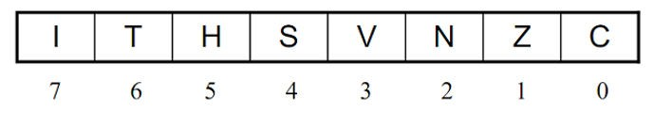
Status Register (SREG)

Slide 4
Status Register (SREG)
Status Register Bits
Bit 7 (I): Global Interrupt Enable
Used to enable and disable interrupts.
1 means enabled and 0 means disabled.
Cleared by hardware after an interrupt has occurred and set by the RETI instruction to enable subsequent interrupts.
Bit 6 (T): Bit Copy Storage
The Bit Copy Instructions such as BLD (Bit Load) and BST (Bit Store) use the T-bit as source or destination for the operated bit.

Slide 5
Status Register (SREG)
Bit 5 (H): Half Carry Flag
Indicates half carry (carry from bit-4).
Useful is BCD arithmetic.
Bit 4 (S): Sign Bit
Exclusive OR between N and V
𝑆=𝑁⊕𝑉
Bit 3 (V): Overflow Flag
The overflow flag is used to detect errors in signed arithmetic operations.

Slide 6
Status Register (SREG)
Bit 2 (N): Negative Flag
The most significant bit of the result.
1 means negative and 0 means positive.
Bit 1 (Z): Zero Flag
Indicates a zero result in an arithmetic or logic operation.
1 means result is zero and 0 means result is non-zero.
Bit 0 (C): Carry Flag
Set if there was carry from the MSD of the result.

Slide 7
Manipulating the bits of general purpose registers
Setting The bits
The SBR(set bits in register) instruction sets the specified bits in the general purpose register. It has the following format:
SBR Rd, K ; set bits in register Rd
K is an 8-bit value that can be 00-FF in hex and Rd is R16 to R31.
For example, in the following program the SBR instruction sets the bits 2, 5 and 6 regardless of their previous values.
LDI R17, 0b01011001 SBR R17, 0b01100100
When Execution of the above instructions in finished, R17 contains 0x7D
Perform ORI between Rd and K then load the value into Rd.

Slide 8
Manipulating the bits of general purpose registers
Clearing The bits
The CBR(clear bits in register) instruction clears the specified bits in the general purpose register. It has the following format:
CBR Rd, K ; clear bits in register Rd
K is an 8-bit value that can be 00-FF in hex and Rd is R16 to R31.
For example, in the following program the CBR instruction sets the bits 2, 5 and 6 regardless of their previous values.
LDI R17, 0b01011001 CBR R17,0b01100100
When Execution of the above instructions in finished, R17 contains 0x19
Perform ANDI between Rd and complement-K then load the value into Rd.

Slide 9
Copying a bit
The T bit in SREG is used when we want to copy a bit of data from one GPR to another GPR.
The BST ( Bit store from register to T)
The BLD( Bit Load from T to register)
These instructions can be used to copy a bit of register to a specific bit of another register.
For example, the following program copies bit 3 from R17 to bit 5 in R19:
BST R17, 3
BLD R19, 5
;store bit 3 from R17 to the T flag
;Copy the T flag to bit 5 in R19

Slide 10
LCD Interfacing
An LCD is an electronic display module which uses liquid
crystal to produce a visible image.
The 16×2 LCD display is a very basic module.
The 16×2 liquid crystal display contains two horizontal lines.
In inbuilt, the LCD has two registers:
Command Register
Data Register

Slide 11
LCD Interfacing
Command Register: The command register stores the command instructions given to the LCD. A command is an instruction given to LCD to do a predefined task like initializing it, clearing its screen, setting the cursor position, controlling display etc. Processing for commands happens in the command register.
Data Register: The data register stores the data to be displayed on the LCD. The data is the ASCII value of the character to be displayed on the LCD. When we send data to LCD it goes to the data register and is processed there. When RS=1, data register is selected.

Slide 12
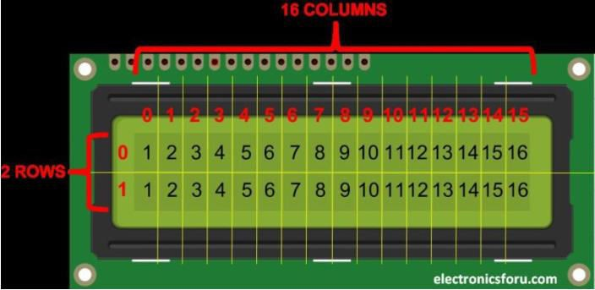
LCD Interfacing

Slide 13
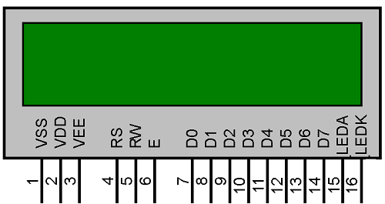
LCD pin descriptions

Slide 14
LCD pin descriptions
Pin No | Pin Name | Pin Description
Pin 1 | GND | This pin is a ground pin and the LCD is connected to the Ground.
Pin 2 | VCC | The VCC pin is used to supply the power to the LCD.
Pin 3 | VEE | This pin is used for adjusting the contrast of the LCD by connecting the variable resistor in between the VCC & Ground.

Slide 15
LCD pin descriptions
Pin No | Pin Name | Pin Description
Pin 4 | RS | The RS is known as register select and it selects the Command/Data register. To select the command register the RS should be equal to zero. To select the Data register the RS should be equal to one.
Pin 5 | R/W | This pin is used to select the operations of Read/Write. To perform the write operations the R/W should be equal to zero. To perform the read operations the R/W should be equal to one.

Slide 16
LCD pin descriptions
Pin No | Pin Name | Pin Description
Pin 6 | EN | This is a enable signal pin if the positive pulses are passing through a pin, then the pin function as a read/write pin.
Pin 7- Pin 14 | D0 to D7 | The 8-bit data pins, D0 –D7, are used to send information to the LCD or read the contents of the LCD’s internal registers.

Slide 17
LCD pin descriptions
Pin No | Pin Name | Pin Description
Pin 15 | LED + | Turn on LED backlight
Pin 16 | LED - | Turn off the LED backlight

Slide 18
Circuit
To wire LCD screen to Arduino board, connect the following pins:
LCD RS pin to digital pin 12
LCD Enable pin to digital pin 11
LCD D4 pin to digital pin 5
LCD D5 pin to digital pin 4
LCD D6 pin to digital pin 3
LCD D7 pin to digital pin 2
Additionally, wire a 10k pot to +5V and GND, with it's wiper (output) to LCD screens VO pin (pin3). A 220 ohm resistor is used to power the backlight of the display, usually on pin 15 and 16 of the LCD connector

Slide 19
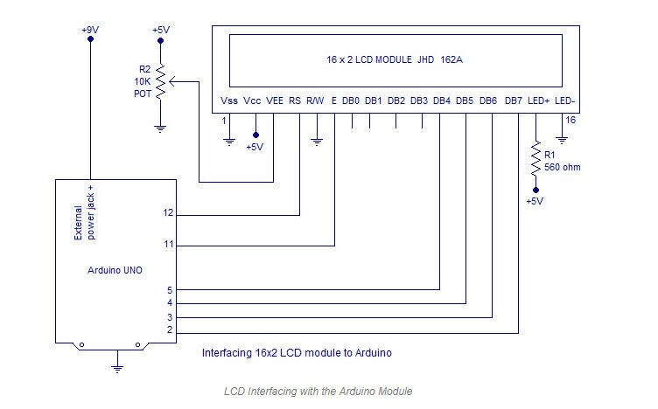
Schematic

Slide 20
Code
const int rs = 12, en = 11, d4 = 5, d5 = 4, d6 = 3, d7 = 2; LiquidCrystal lcd(rs, en, d4, d5, d6, d7);
void setup() { lcd.begin(16, 2); lcd.print("hello, world!");
}
void loop() { lcd.setCursor(0, 1);
lcd.print(millis() / 1000);
}

Slide 21
LiquidCrystal()
Description
Creates a variable of type LiquidCrystal. The display can be controlled using 4 or 8 data lines. If the former, omit the pin numbers for d0 to d3 and leave those lines unconnected. The RW pin can be tied to ground instead of connected to a pin on the Arduino; if so, omit it from this function's parameters.
Syntax
LiquidCrystal(rs, enable, d4, d5, d6, d7) LiquidCrystal(rs, rw, enable, d4, d5, d6, d7) LiquidCrystal(rs, enable, d0, d1, d2, d3, d4, d5, d6, d7)
LiquidCrystal(rs, rw, enable, d0, d1, d2, d3, d4, d5, d6, d7)

Slide 22
LiquidCrystal()
Parameters
rs: the number of the Arduino pin that is connected to the RS pin on the LCD
rw: the number of the Arduino pin that is connected to the RW pin on the LCD (optional)
enable: the number of the Arduino pin that is connected to the enable pin on the LCD d0, d1, d2, d3, d4, d5, d6, d7: the numbers of the Arduino pins that are connected to the corresponding data pins on the LCD. d0, d1, d2, and d3 are optional; if omitted, the LCD will be controlled using only the four data lines (d4, d5, d6, d7).

Slide 23
LiquidCrystal()
#include <LiquidCrystal.h>
LiquidCrystal lcd(12, 11, 10, 5, 4, 3, 2); void setup()
{
lcd.begin(16,1); lcd.print("hello, world!");
}
void loop() {}

Slide 24
4x4 Keypad Interfacing
Keypad is used as an input device to read the key pressed by the
user and to process it.
4x4 keypad consists of 4 rows and 4 columns. Switches are placed between the rows and columns.
Keyboards are organized in a matrix of rows and columns. When a key is pressed, a row and a column make a contact Otherwise; there is no connection between rows and columns.

Slide 25
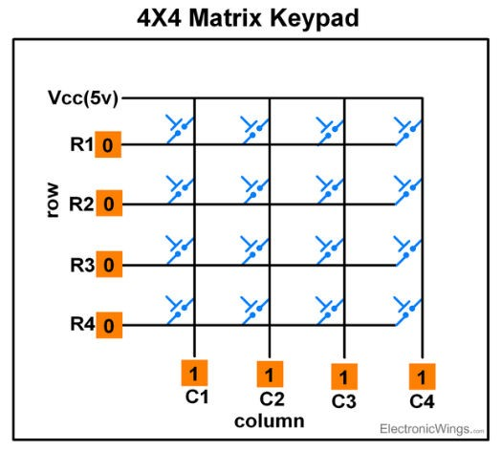

Slide 26
Keypad Matrix Working
Scanning of Keys
To detect a pressed key, the microcontroller grounds all rows by providing 0 to the output latch, and then it reads the columns.
If the data read from columns is = 1111, no key has been pressed and the process continues till key press is detected.
After pressing key, it makes contact of row with column.

Slide 27
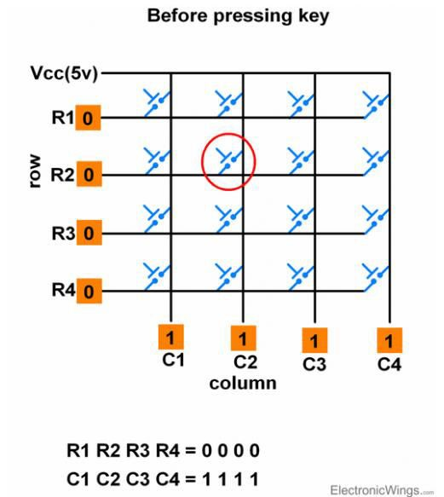

Slide 28
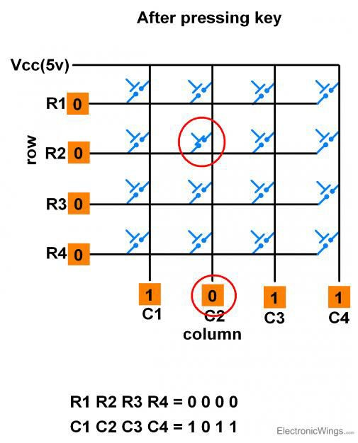

Slide 29
Keypad Matrix Working
Scanning of Keys
If one of the column bits has a zero, this means that a key press has occurred.
For example, if C1:C4 = 1011, this means that a key in the C2
column has been pressed.
After detecting a key press, microcontroller will go through the process of identifying the key.

Slide 30
Keypad Matrix Working
Process of Identifying the Key
Starting from the top row, the microcontroller will ground it by providing a low to row R1 only.
Now read the columns, if the data read is all 1s, no key in that
row is pressed and the process continues for the next row.
So, now ground the next row, R2. Read the columns, check for any zero and this process continues until the row is identified.
E.g. In above case we will get row 2 in which column is not
equal to 1111.
So, after identification of the row in which the key has been pressed we can easily find out the key by row and column value.

Slide 31
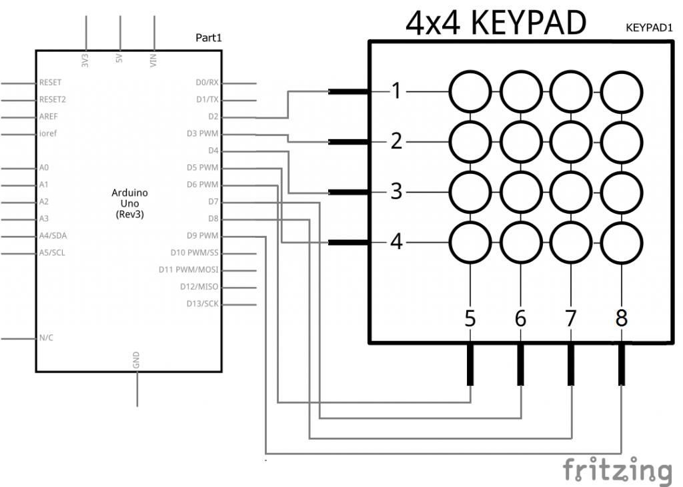
Schematic

Slide 32
#include <Keypad.h> const byte ROWS = 4; const byte COLS = 4;
char keys[ROWS][COLS] = {
{'1','2','3','A'},
{'4','5','6','B'},
{'7','8','9','C'},
{'*','0','#','D'}
};
byte rowPins[ROWS] = { 2,3,4,5 }; byte colPins[COLS] = { 6,7,8,9};
Keypad kpd = Keypad( makeKeymap(keys), rowPins, colPins, ROWS, COLS ); void setup(){
Serial.begin(9600); }
void loop(){
char key = kpd.getKey(); if(key) {
Serial.println(key); }
}

Slide 33
THANK YOU

